Slide 1
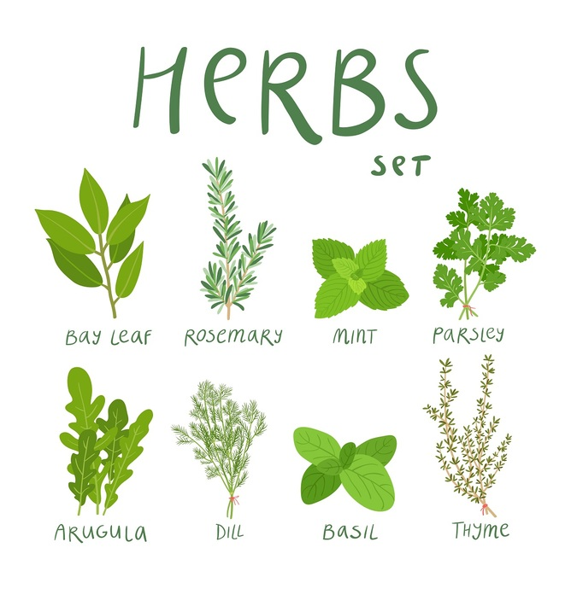
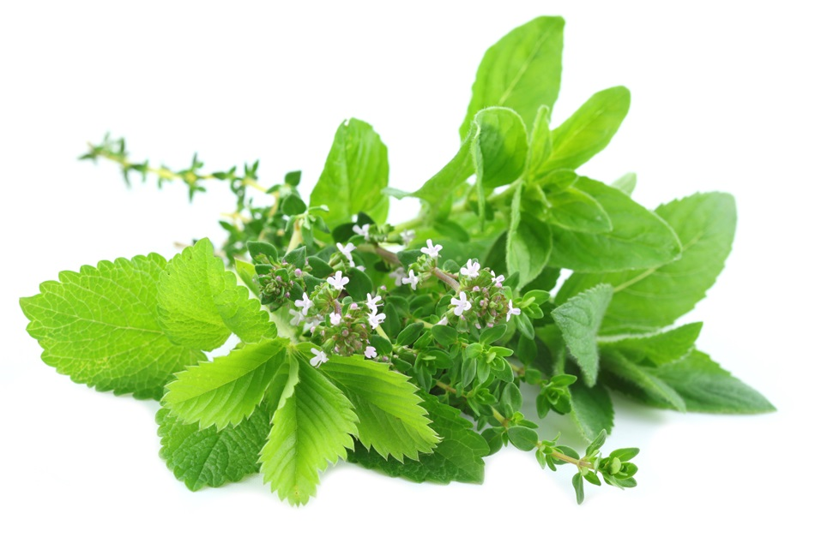
Herbs

Slide 2
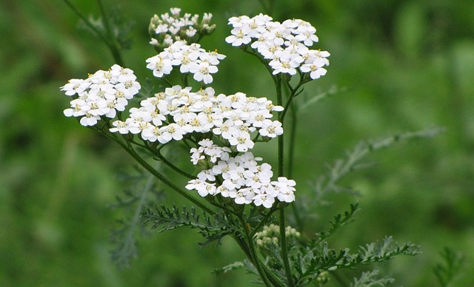
The magical power of Yarrow
Yarrow is used for divination and love spells and in spells for contacting or seeking out a specific person.
Yarrow tea can also be drunk prior to divination, and to help the mind focus on a specific issue, or avoid distractions. Especially useful for psychic communication with a loved one and, when in times of strife, can help you and your loved one see things from each others' point of view.
Hanging a bunch of yarrow over the bed on the wedding night is supposed to ensure lasting love for seven years. Adding it to the bouquet or garlands worn by the bride or groom serves the same affect.
Back in the day, hanging a bunch of yarrow over a cradle was said to protect a baby from witches trying to steal its soul.
It is used also as a charm for pregnant woman; keep it on the right side to have an easy labor.
Yarrow strewn across a threshold will prevent unhelpful spirits from entering.
http://www.witchipedia.com/herb:yarrow

Slide 3
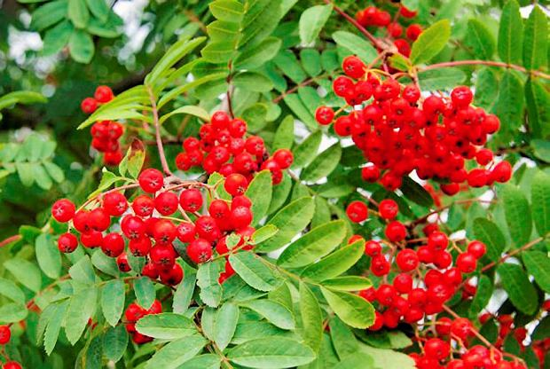
The magical power of Rowan
There is much folklore associated with Rowan being used to create magick and to dispel magick. Depending upon the writer and the century, it is used by witches and the fairy folk or to banish them and their workings. Rowan’s voice is heard by spiritual forces and its power is shared with those who honor it regardless of their particular faith. The berries were used by the Druids and Welsh witches in brewing wines and potions that increased the power of the second sight. All wood has the capacity to store the imprint of magickal energy, information, and essence, but Rowan wood has a huge capacity to do so. This is one of the reasons that Rowan wood is excellent for making magickal tools, talismans, charms, etc
http://www.seeliecourt.net/panpipe/rowanuse.html

Slide 4
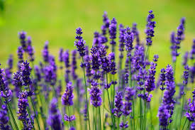
The magical power of Lavender
Lavender is masculine in action and associated with Mercury in Culpeper's Herbal. It is also associated with the element of air and the astrological sign Virgo. It may be used as an asperging herb (to sprinkle water for purification purposes) and dried lavender sticks or wands can be burnt like incense. It is also useful in spells to sharpen the mind, to encourage or strengthen pure love and to encourage fertility.
http://www.witchipedia.com/herb:lavender

Slide 5
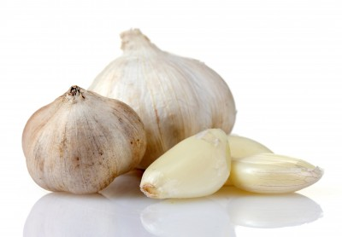
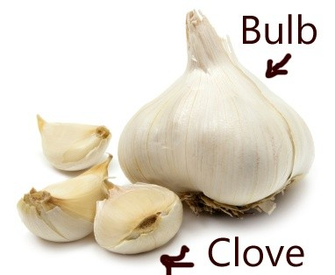
The magical power of Garlic cloves
Garlic braids hung over the door repel thieves and envious people as well as bring good look. Change the braid every year. Hanging garlic over a bedroom door will draw lovers into it.
Garlic is said to have aphrodisiac powers when eaten.
Wiping a knife with garlic juice empowers it against negative energies.
A clove of garlic can be added to any mojo bag to strengthen its energy.
Garlic is used for exorcism, spell-breaking, invoking passion, protection and strength.
Also used to protect against psychic and physical vampirism.
https://wicca.com/celtic/herbal/magickall.htm

Slide 6
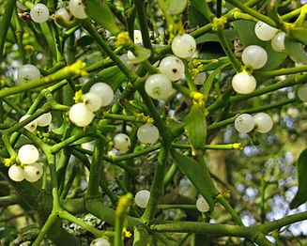
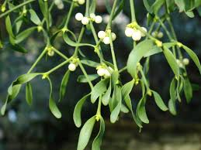
The magical power of Mistletoe
Use in spells to attract love, for protection, for luck while hunting, for forgiveness and reconciliation, to increase sexual potency in men and to help conceive.
It can be burned to banish unwanted spirits, laid across the threshold of the bedroom to banish unpleasant dreams, hung in the home to attract love and drive away negative influence and carried as a general protective amulet.
Its wood is useful for making wands and other ritual tools.
http://www.witchipedia.com/herb:mistletoe

Slide 7
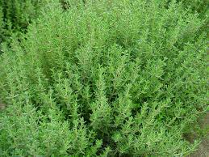
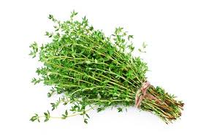
The magical power of Thyme
Can be used in magick spells to increase strength and courage.
When working hard to achieve a goal that seems un-achievable, thyme can be used in spells to help you keep a positive attitude.
Fumigate your home with thyme to dispel melancholy, hopelessness and other mellow but negative vibrations, especially after a family tragedy or during a long sickness.
Place thyme beneath your pillow for a restful sleep and happy dreams and to prevent nightmares.
Faeries love thyme. Its addition to your garden will attract them and it can be used in spells to communicate with faeries.
Thyme is excellent in ritual baths and fumigation for early spring festivals when we seek to leave the old behind and begin anew.
http://www.witchipedia.com/herb:thyme

Slide 8
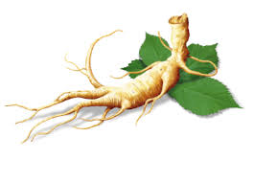
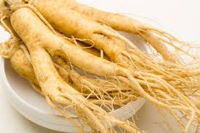
The magical power of Ginseng
In modern magick, Ginseng root is carried to attract love, ensure sexual potency, enhance beauty, draw money, and promote general good health and vitality. It is also associated with protection, fulfillment of wishes, and spirituality. To attract love, fill a red or pink flannel bag with a lock of your own hair, a heart-shaped piece of sun-dried lemon peel, and a piece of dried Ginseng root. Consecrate and charge it, then wear it on a gold chain around your neck.
Burning Ginseng root or powder as an incense is believed to ward off evil, break hexes or curses, repel negative spirits, and provide visualization fulfillment
Drunk as a tea, Ginseng is believed to be a powerful lust-provoking aphrodisiac
http://www.gardensablaze.com/HerbGinsengMag.htm

Slide 9
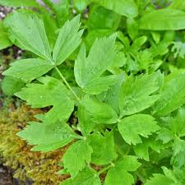
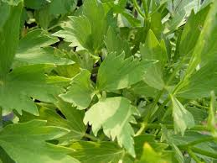
The magical power of lovage
Magical uses:Add the dried and powdered root to cleansing and purification baths to release negativity. Carry to attract love and the attention of the opposite sex. To increase passion in someone special, folks carry a red flannel bag in which they place 3 slices of Bo' HOG ROOT
http://herb-magic.com/lovage.html
https://wicca.com/celtic/herbal/magickall.htm

